Slide 1

Team 03 Cracking the Code: Predicting Fracture Risk in Men using Health and Lifestyle Data

Slide 2
The Challenge Ahead
Osteoporotic fractures are a growing concern.
20-30% of all men will have an osteoporotic fracture in their lifetime
20% of hip fracture patients require long-term nursing home care
33% of people are completely dependent following hip fracture
Timely identification of individuals at high risk can lead to proactive management and significant reduction in healthcare complications and costs. Our challenge was to devise a tool that helps healthcare practitioners swiftly identify these high-risk individuals, enabling timely interventions.
Adler RA. Osteoporosis in men: a review. Bone Res. 2014 Apr 29;2:14001. doi: 10.1038/boneres.2014.1. PMID: 26273515; PMCID: PMC4472130.

Slide 3
Introduction
Project Overview
Predicting non-traumatic fracture risk in men over 50, with an emphasis on health and lifestyle factors
Objective
Build a predictive model for fracture risk that can be used as a screening tool for health practitioners to help identify individuals at higher risk and recommend early interventions
Outcome
A predictive model that effectively identifies over 80% of men aged 50 and above who are at risk of experiencing a fracture

Slide 4
Data Acquisition
Well known public Research data: The Osteoporotic Fractures in Men (MrOS) Study
Multi-center observational study of 5,994 men from six clinical centers in the U.S.
Baseline examinations conducted between 2000-2002
Wide variety of variables
Focus on three datasets
Bone Density (B1AUG16)
Baseline Clinical Visit (V1FEB23)
Fracture Outcome (FAFEB23)
Notes:
Variables include: visual and cognitive function tests, bone mineral density (BMD), the collection of biospecimens, mobility, and objective assessment of physical activity levels

Slide 5
Data Carpentry
Methods
B1 Bone Mineral Density (BMD) data analyzed and consolidated with Principle Component Analysis (PCA)
Correlation Feature Reduction used to shrink the number of features
V1 Lifestyle and Health forms were separated and cleaned
Null values were handled through various methods
Reviewed study documentation and annotated clinical forms to find appropriate replacements
Survey responses had “chained responses” – often filled with zero (No)
Imaging problems during the DEXA scan imputed from a patient’s known DEXA values using K-Nearest Neighbors (KNN).
One hot encoding of categorical values (occupation, education, etc.)
Outcome variable number of any non-traumatic fractures (FAFXNT) converted to binary
Synthetic Minority Over-sampling Technique (SMOTE) used to balance dataset
Datasets were then merged

Slide 6
Methods
Modeling
Supervised Learning Ensemble models
Random Forest, Light GBM, XGBoost
Greater degree of understanding behind feature importance
Train, Test and Validation split (80/10/10)
Optuna Hypertuning performed on each model
Decision threshold adjustments for a focus on recall
Use case as a screening tool rather than diagnostic
Notes:
Decision threshold: achieve a recall between .8-.9, followed by the highest F1 score.

Slide 7

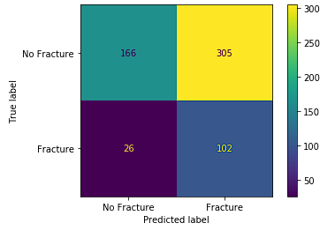
Results
Model Performance
Highest performer: XGBoost
Correctly identifies 80% of patients that experienced a fracture (103 of 128 cases).
While the model incorrectly predicts fracture in 63% of patients that did not experience fracture, we consider these as an increased safety net where missed high-risk cases could have severe implications

Slide 8
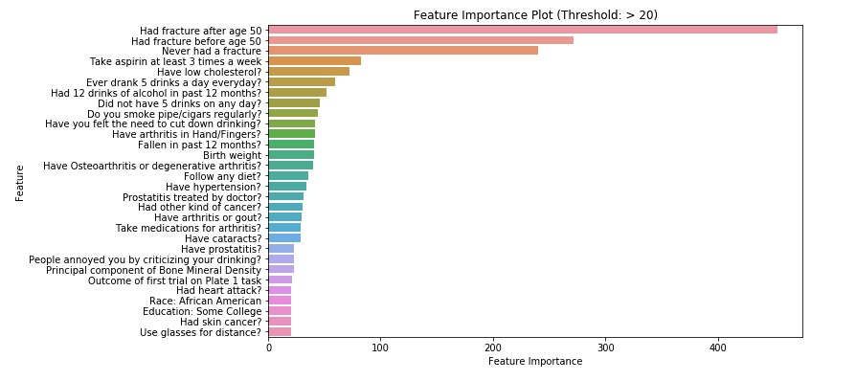
Risk Factor Identification
Results
Identifies risk factors for fractures based on feature importance.
Feature importance was extracted from the tree-based models.
Health Practitioners could take these risk factors into account when discussing lifestyle interventions.
Common elements in the feature importance extracted from our models:
Bone Mineral Density
Previous occurrence of fracture
Excessive alcohol consumption
High aspirin usage

Slide 9
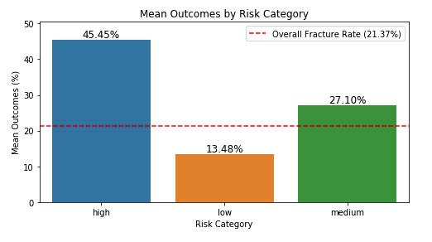
Results
OUtcomes
Stratification of risk for patients and continued monitoring
Among patients in the high-risk category, nearly 45.5% experienced a fracture, far exceeding the overall fracture rate of 21.37% in the dataset.
Those categorized as medium risk had a fracture incidence of 27.1%, also above the overall fracture rate.
Meanwhile, the low-risk group had a fracture rate of just 13.5%, significantly lower than the average.

Slide 10
Results
Limitations
Only effective with data like model environment
Requires some diagnostic and clinical measurements
Limited to men above the age of 50
MRoS dataset is exclusively male
Large amount of false positives
Screening tool only

Slide 11
Results
Next Steps
Future efforts can focus on refining the model with additional and more diverse data.
We also look forward to feedback from healthcare practitioners who apply this model, as their insights will be invaluable in further enhancing its utility.

Slide 12
Conclusion - Benefits
Targeted Interventions: By identifying those at a high risk of fractures, healthcare practitioners can direct preventative measures and interventions to those who need them most. This includes recommending lifestyle changes, prescribing medication to strengthen bone density, or initiating other treatments as deemed necessary.
Efficient Use of Resources: Healthcare resources are often limited. By distinguishing the patients who are at a higher risk of fractures, resources can be allocated more efficiently, focusing on those most in need.
Early Detection and Prevention: With the ability to predict who is at high risk of fractures, healthcare practitioners can take proactive steps to manage and potentially reduce that risk, preventing fractures before they occur. This can significantly improve patient outcomes and quality of life, particularly for those at high risk.
Key Risk Factors Identified: Healthcare practitioners can address these risk factors for high-risk patients through preventive interventions. These include Bone Mineral Density, Previous occurrence of fracture, Excessive alcohol consumption, and High aspirin usage.

Slide 13
Conclusion
Our study attempts to utilize the power of predictive analytics, in hopes to aid healthcare practitioners in their ongoing battle against osteoporotic fractures.
While an effective tool, is intended to supplement—not replace—professional medical judgement. The outcomes should always be interpreted within full clinical context and alongside other relevant risk factors.
Through early identification of high-risk individuals, healthcare practitioners can recommend proactive interventions, helping prevent fractures before they occur. This not only improves patient outcomes but can also lead to a more efficient allocation of healthcare resources.

